Slide 1
Technical Sales Vault plm Client Extensions
Integrating PLM workflows with CAD-PDM
Sven Dickmans
Markus Koechl
Solutions Engineer PDM|PLM
Solutions Engineer PDM|PLM

Slide 2
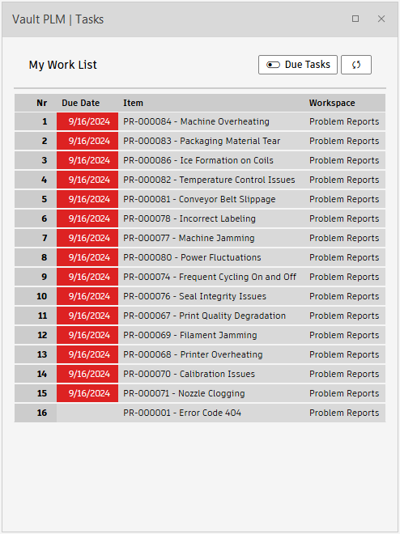
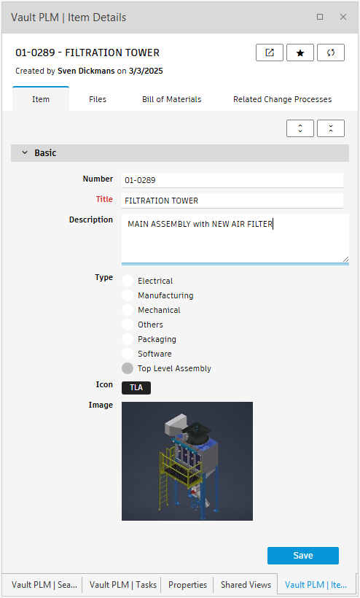
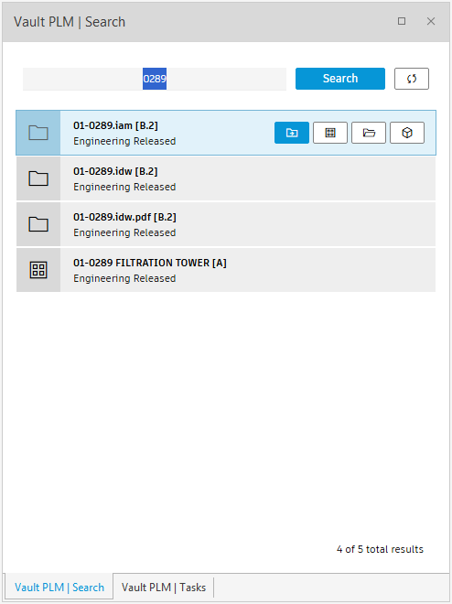
Agenda
Vault plm extensions for Vault and Inventor
Positioning and outcome options
Use case - engineering task sample
PDM-centric workflow option
CAD-centric workflow option
Installation
MSI Installer
Individual configuration settings
Looking behind the scenes

Slide 3
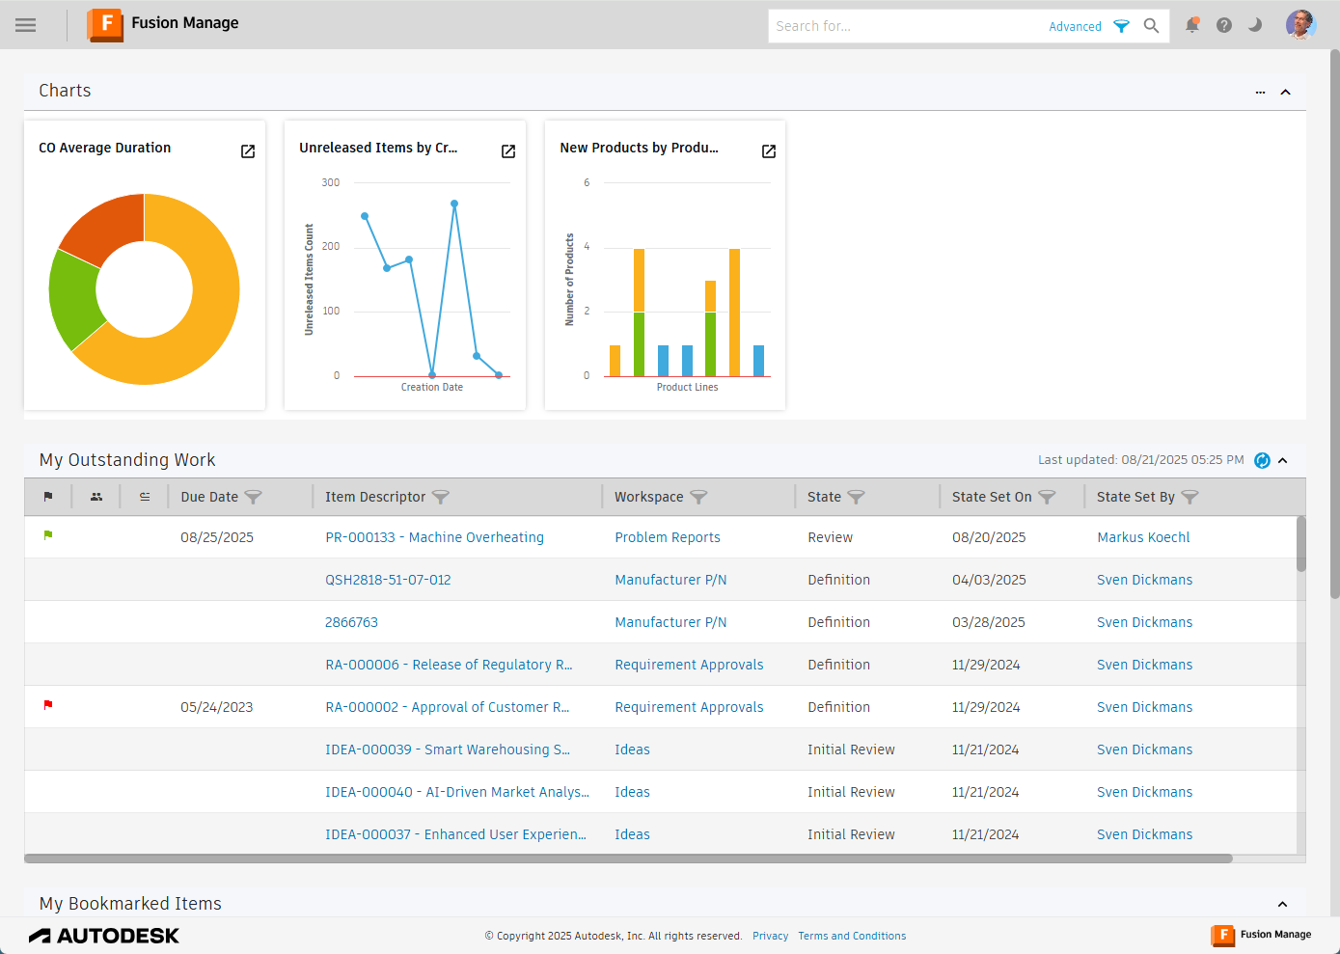
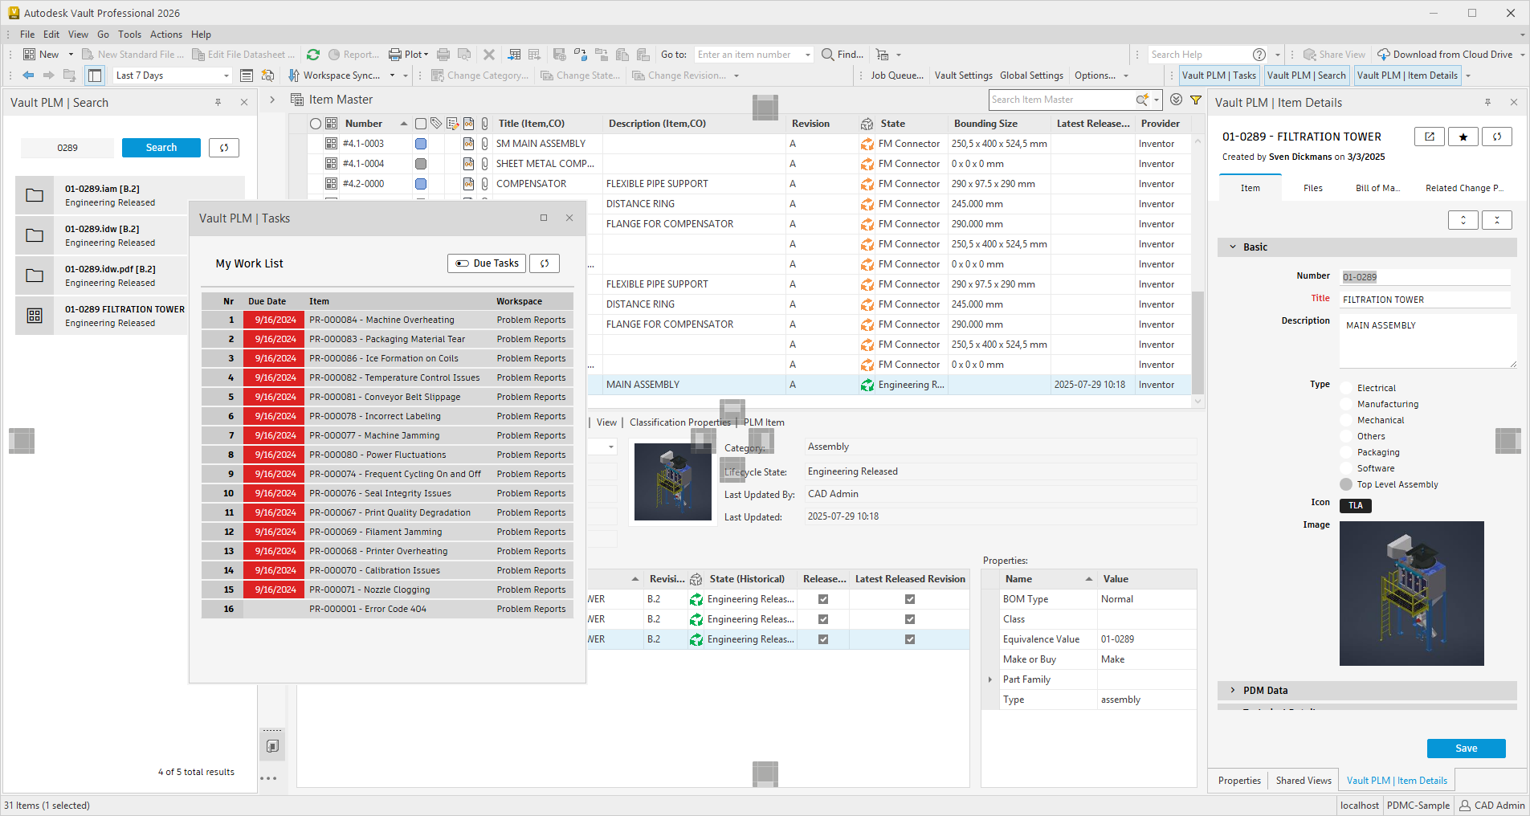
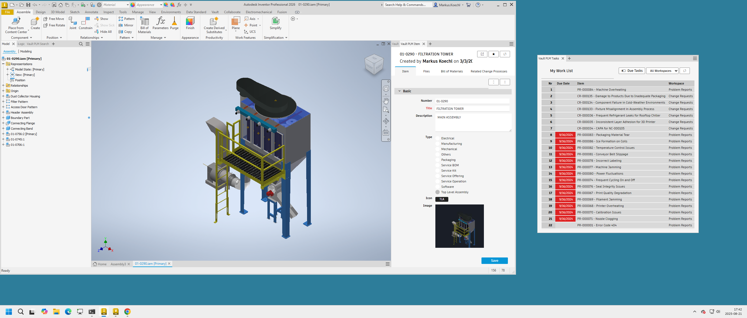
Vault plm Extensions
Positioning and outcome options
The default user interface of the cloud-based PLM system Fusion Manage does not interact with the engineers’ CAD and PDM toolsets. Engineering users want to follow up on their working list of engineering tasks – aka Fusion Manage Dashboard “My Outstanding Work” in the context of their primary tools.
The Technical Sales Vault plm extensions integrate optimized Fusion Manage views into Vault and Inventor clients, providing access to
Engineering tasks
Item Details and Item BOMs
PDM/PLM Search
Product- or Project Workspace(s)
Extended user commands allow completing plm workflows within the CAD/PDM desktop applications

Slide 4
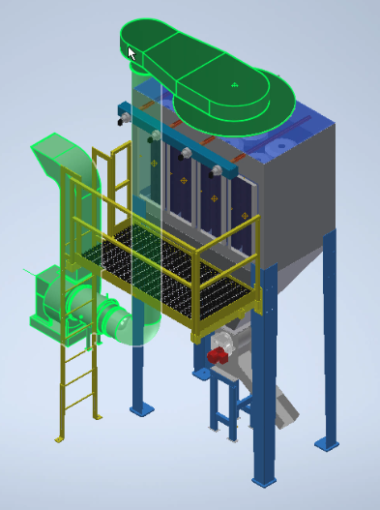
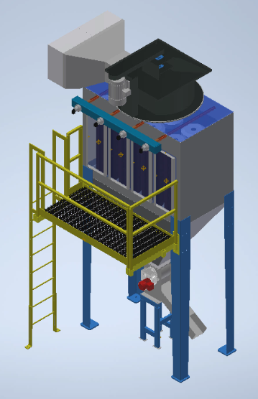
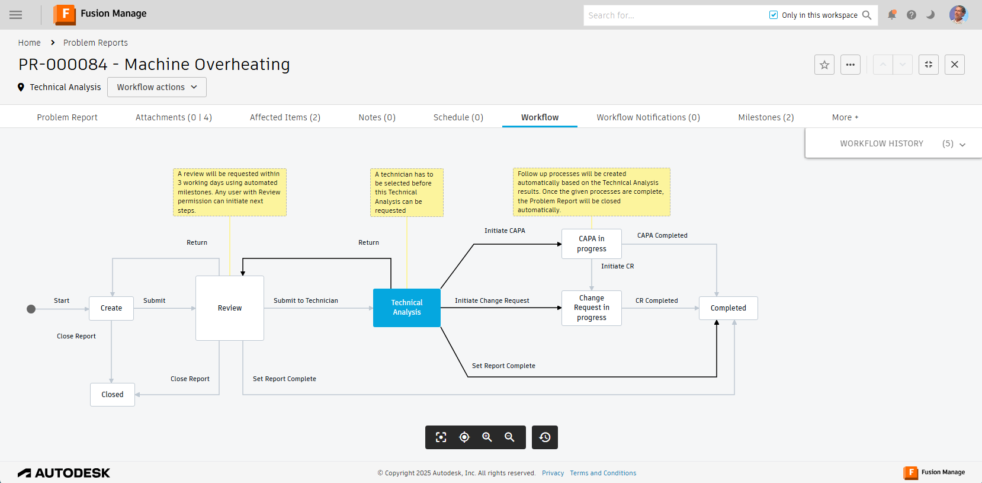
Use Case Sample
Preparing a change evaluation
The engineer drafts a new assembly configuration to prepare extended evaluations on a design change targeting problems in the operational plant.
The engineer’s task is embedded in Fusion Manage processes.
The task linked affected items and suggested a path for the problem resolution.
Real-world scenarios require extended investigations, reviews, and approvals, before a design revision is implemented
The engineer embeds the initial draft into the Fusion Manage workflow

Slide 5
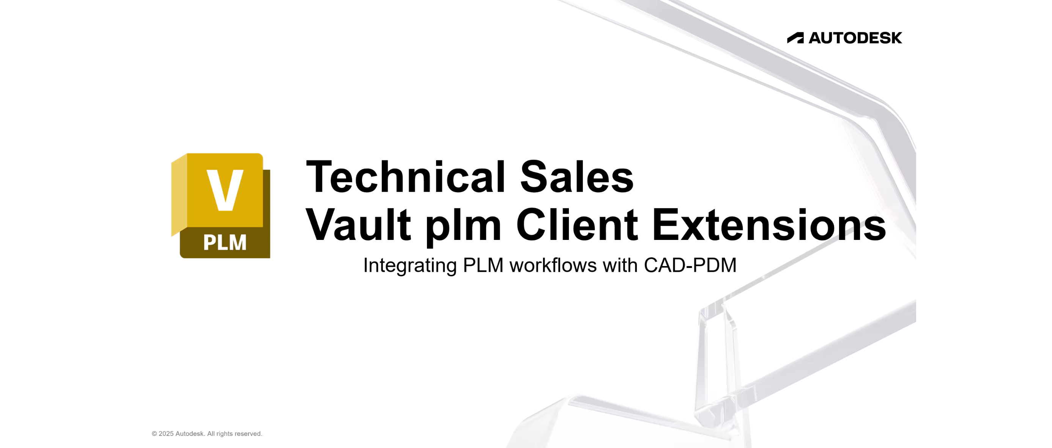
Use Case Demonstration – PDM-centric option

Slide 6
Use Case Demonstration – CAD-centric option

Slide 7
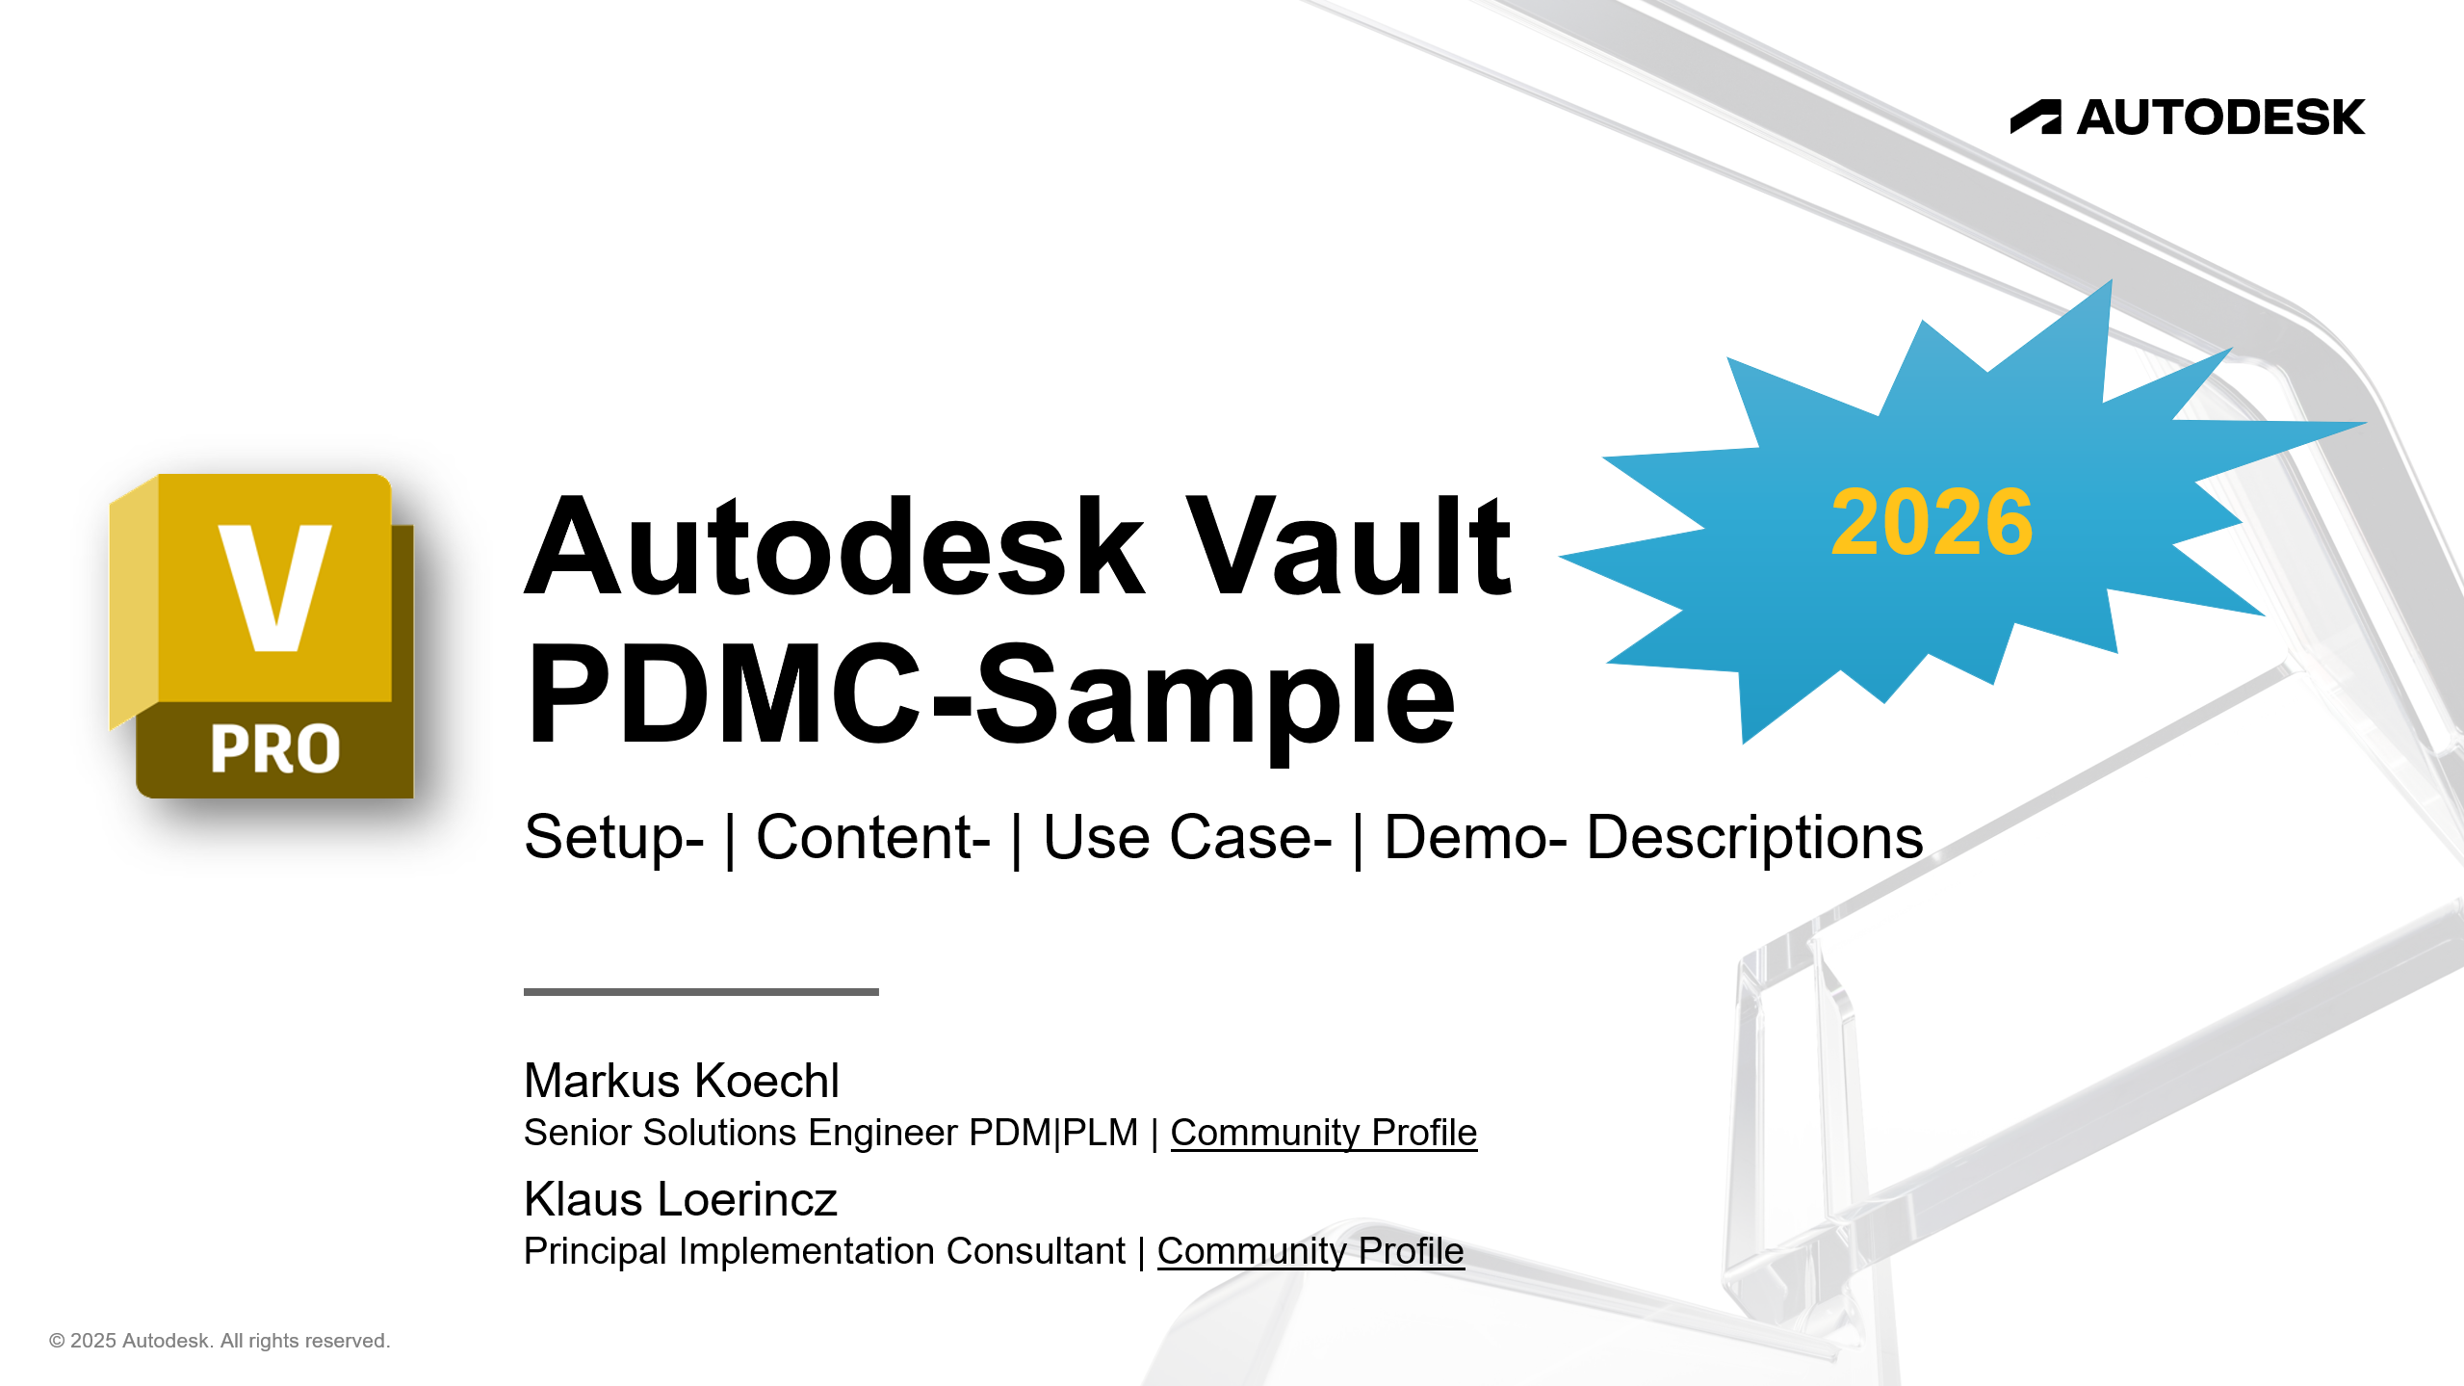
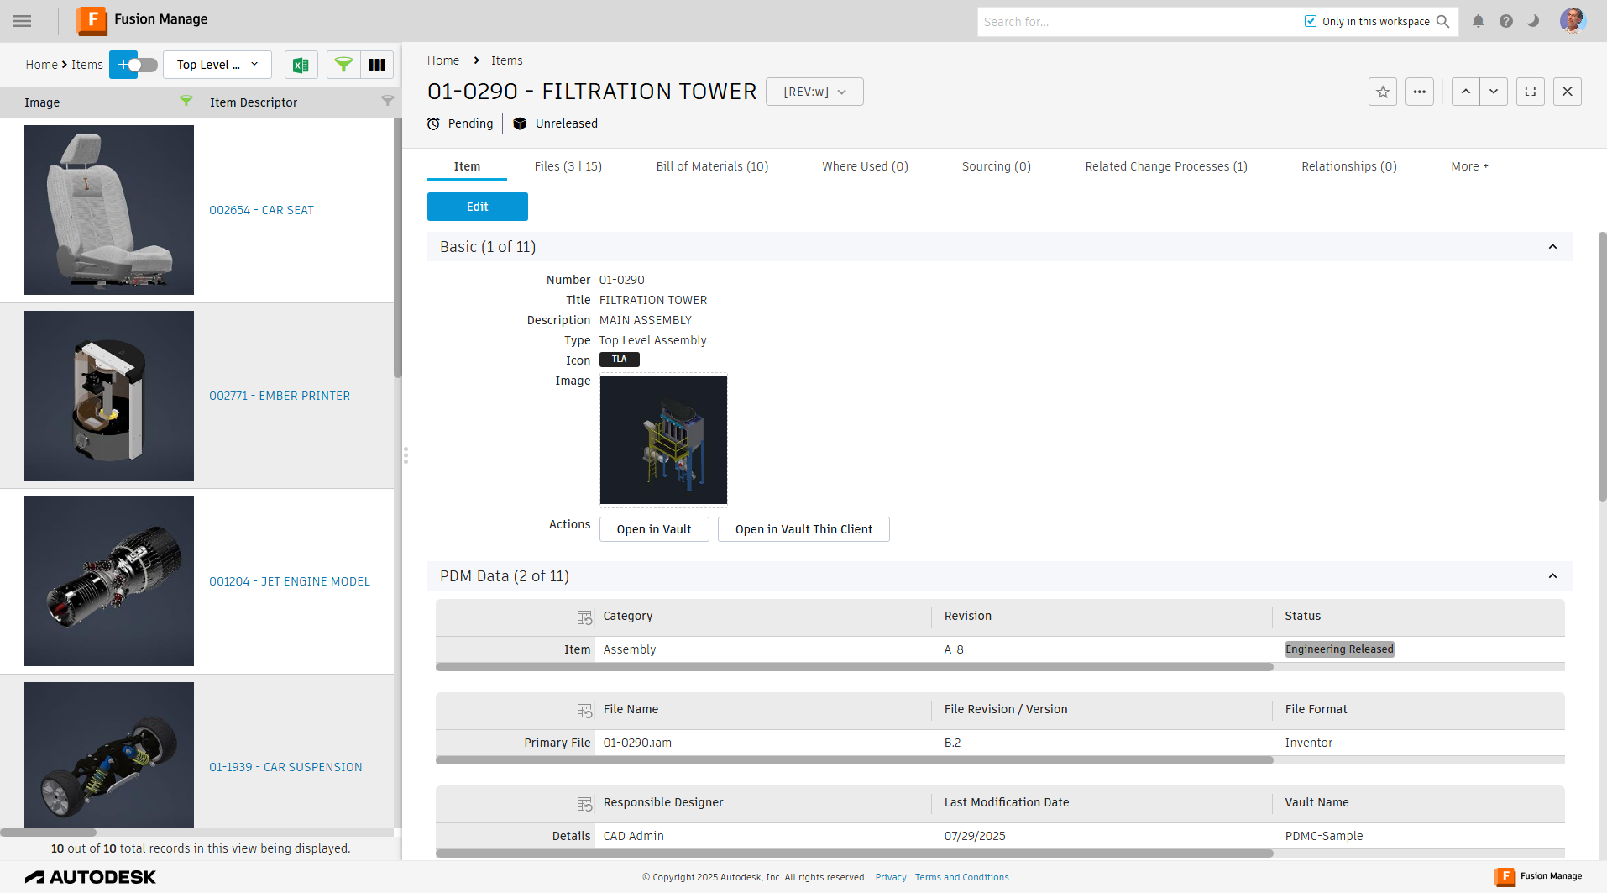
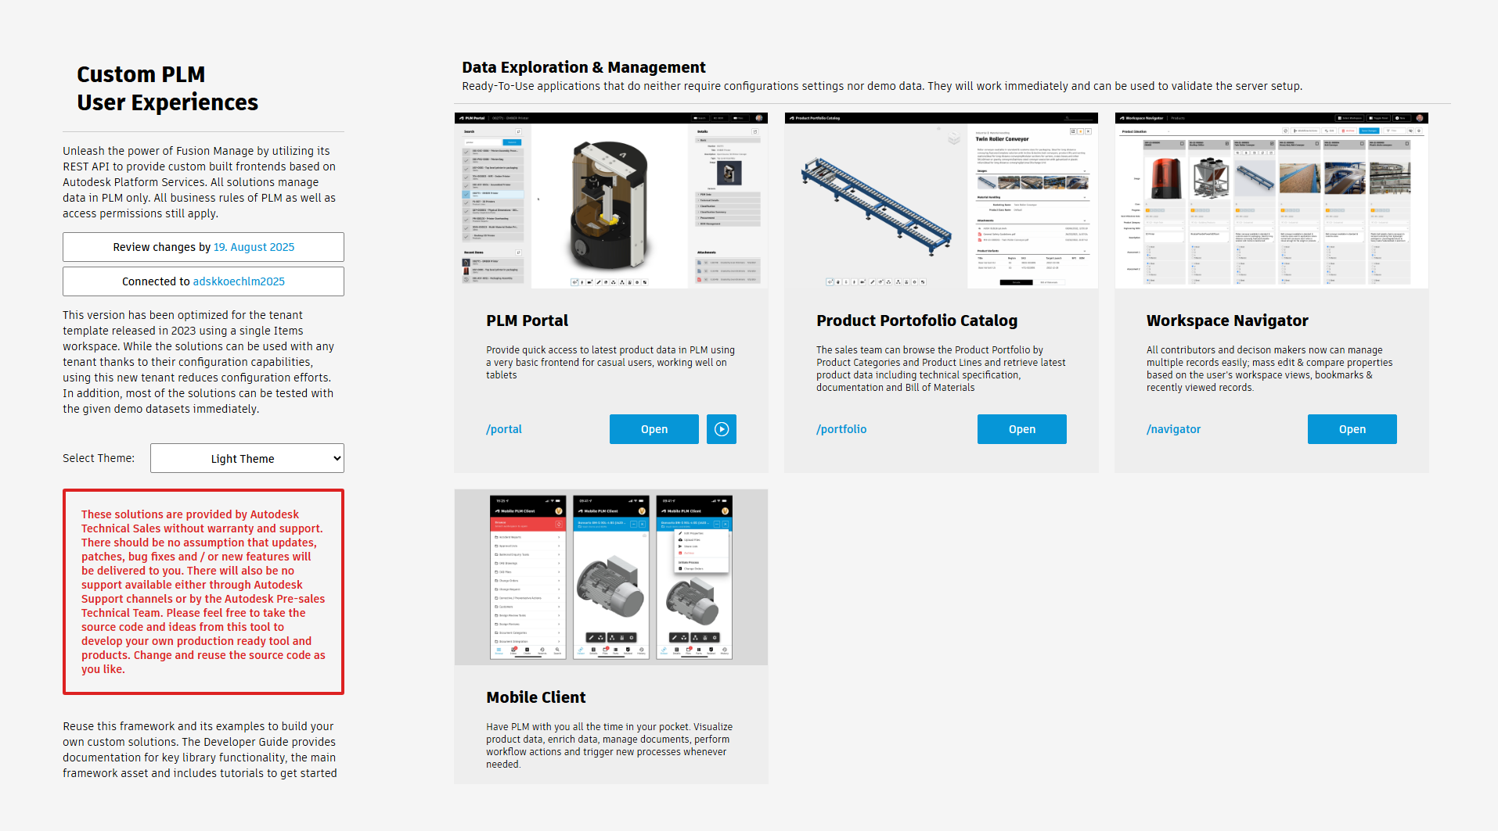
Installation
Prerequisites
Vault Professional 2026 | Inventor 2026
[Recommended]: PDMC-Sample Vault
Fusion Manage tenant with administrative access
Technical Sales PLM User Experience Extension server
Channel Tech | GitHub

Slide 8
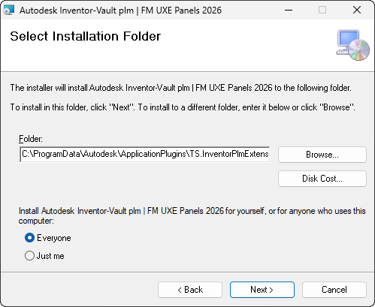
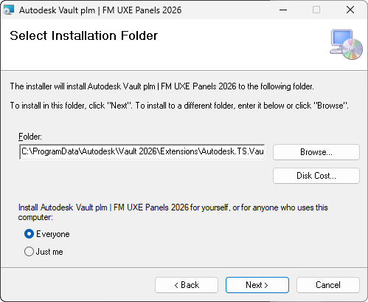
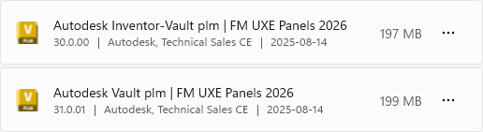
Installation
Download MSI installer
Install with default settings

Slide 9
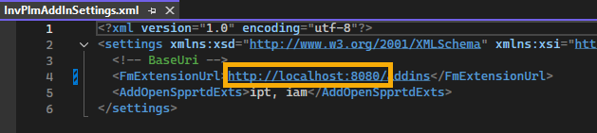
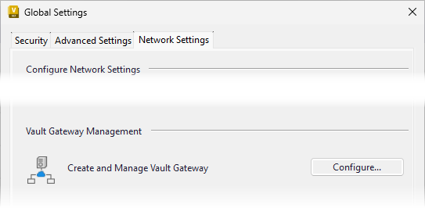
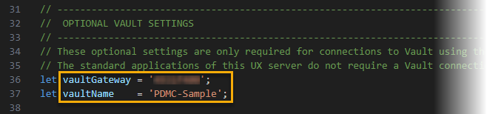
Configuration
UX Extension server connection
Register your PLM User Experience Extension server address
Inventor Addin
C:\ProgramData\Autodesk\ApplicationPlugins\TS.InventorPlmExtension\InvPlmAddInSettings.xml
Vault Extension
C:\ProgramData\Autodesk\Vault 2026\Extensions\Autodesk.TS.VaultPlmExtension\VltPlmAddInSettings.xml
Enable Vault Gateway on your Autodesk Vault Server
ADMS Console -> Administration -> Network Settings -> Vault Gateway
Register your Vault Server Gateway address in the UX Extension settings.js file
Note – the Gateway identifier is sufficient, you don’t need to copy the prefix “https://” and the suffix “vg.autodesk.com”
Notes:
The UX extension server leverages the Vault Data API; Vault Gateway provides the easiest setup, if the UX server is not on your local machine (likely for pre-sales use only) or not within the same domain as the Vault server.

Slide 10
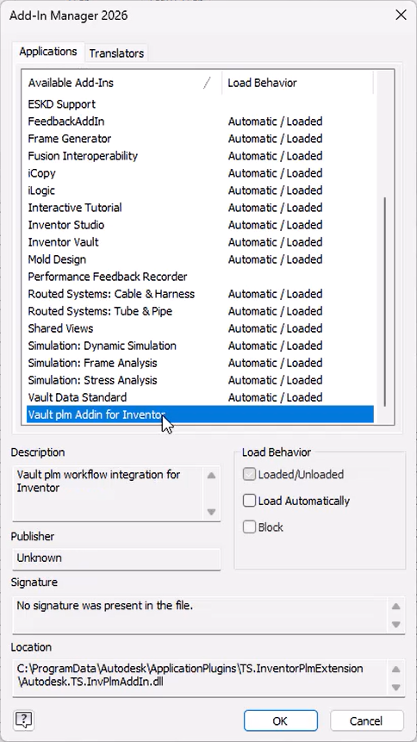
Initial Start
Load Behavior
Inventor Addin
Allow loading of the unsigned Addin in the Inventor Addin Manager
Enable Load on Startup if preferred
Inventor Addin | Vault Extension
Both extensions require an Autodesk Account login on the UX extension server
The extension will skip loading if the login is canceled or fails

Slide 11
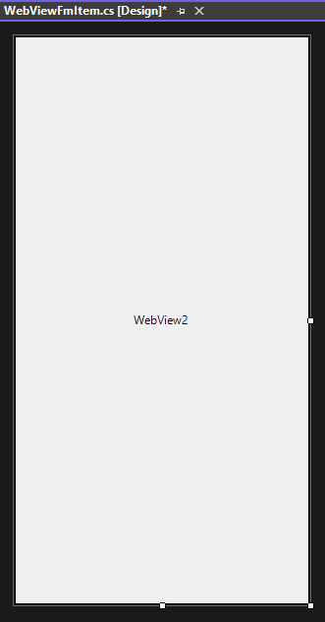

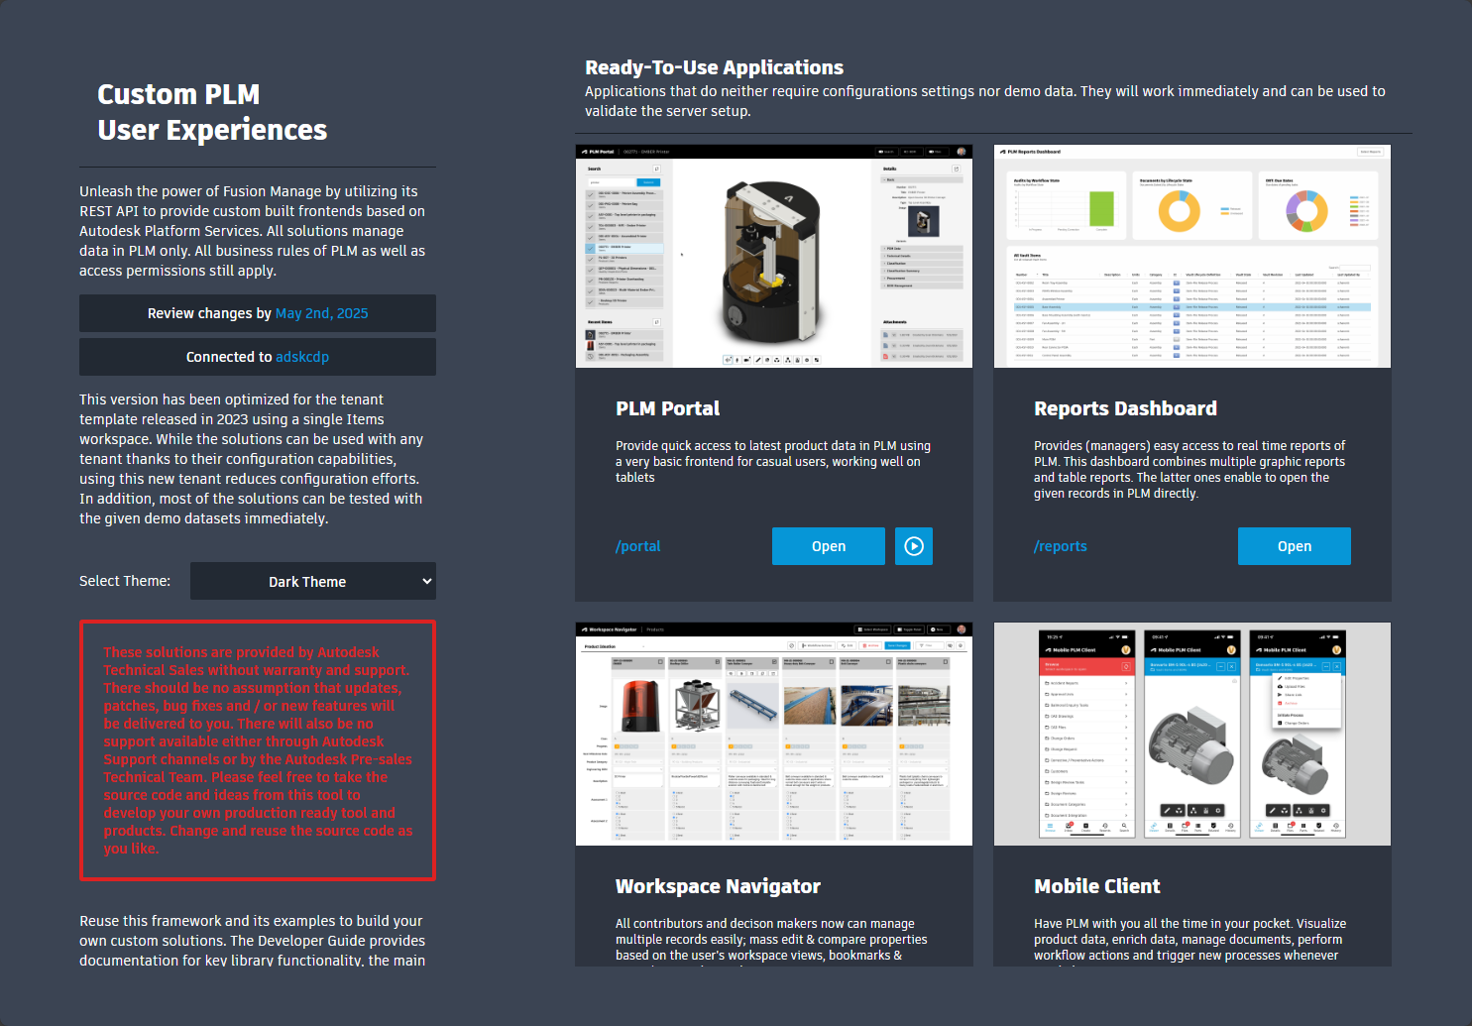

How it works…
Inventor dockable windows | Vault dock-panels = WebView2 controls
WebView2 controls display Fusion Manage UX Extension pages
Optimized layout with host-specific user commands
Messaging for bidirectional host – UXE server communication
Send messages
Call Url
Display
Receive messages
Navigation/Selection Open or Add Component

Slide 12
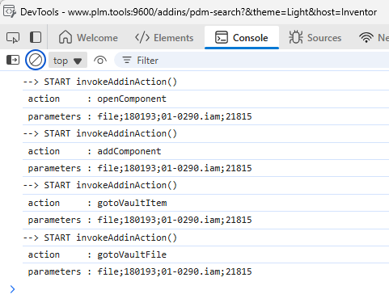
WebMessage Parameters
Source = Vault File
Message format
Action; Source; FileIterationId; Filename.Ext; MasterId
Action Values
openComponent
addComponent
gotoVaultFile
gotoVaultItem
Source Values
file | item | plm-item

Slide 13
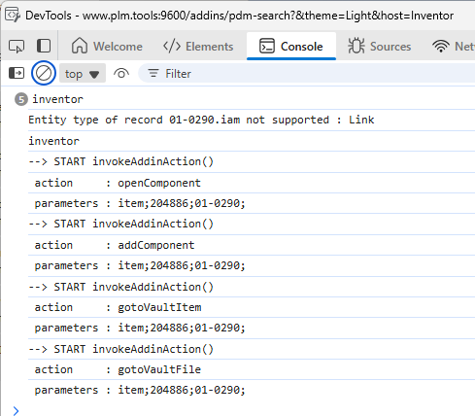
WebMessage Parameters
Source = Vault Item
Message format
Action; Source; ItemRevision(Id); Number
Action Values
openComponent
addComponent
gotoVaultFile
gotoVaultItem
Source Values
file | item | plm-item

Slide 14
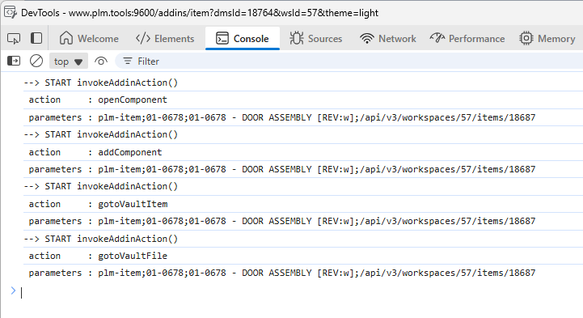
WebMessage Parameters
Source = Fusion Manage Item
Message format
Action; MessageId; Source; Number; Item Descriptor [Rev]; urn
Action Values
openComponent
addComponent
gotoVaultFile
gotoVaultItem
Source Values
file | item | plm-item

Slide 15
WebMessage Parameters
Source = Fusion Manage Item
Message format
Action:MessageId;Source;Number;Item Descriptor [Rev];urn;instancePath
Action Values
openComponent
addComponent
gotoVaultFile
gotoVaultItem
selectComponent
isolateComponent
selectInstance
isolateInstance
Source Values
file | item | plm-item

Slide 16
Summary
TS Vault plm Client Extensions
Leverage the extensions as presales samples to demonstrate customization options of workflows and the user interface
Vault Connector may deliver panels as a default in the future
Continue to leverage the extension templates for custom workspaces, whose content default panels won’t target

